Slide 1

INSTITUTE : UIE
DEPARTMENT : CSE
Bachelor of Engineering (Computer Science & Engineering)
WEB AND MOBILE SECURITY (Professional Elective-I)
(20CST/IT-333)
TOPIC OF PRESENTATION:
Wi-Fi and Bluetooth Security
DISCOVER . LEARN . EMPOWER

Slide 2
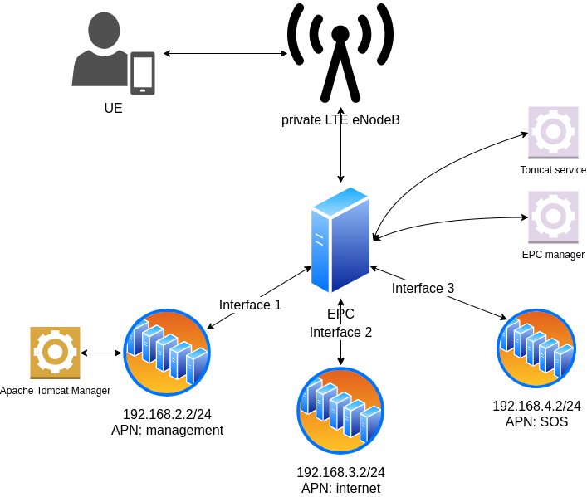
Lecture Objectives
In this lecture, we will discuss:
Bluetooth Security, Wi-Fi Security

Slide 3
Wi-Fi attacks
1. Evil Twin attack:
Here the attacker sets up a fake access point with a similar name to that of a corporate AP near the company premises. When an employee unknowingly connects to this access point thinking that to be the genuine AP of the company, he/she gives away the authentication details of the original access point. The attacker, thus, is able to compromise the connection.
2. Jamming Signals:
An attacker can disrupt the network connection by jamming the signal, there are functioning tools for this purpose also called as creating noise.

Slide 4
Wi-Fi attacks
3. Misconfiguration Attacks:
If a router is set up using the default configuration, weak credentials, weak encryption algorithms, then the attacker can easily break into the network.
4. Honey spot Attack:
An attacker can set up fake access points/hotspots with the same SSID as that of a public wi-fi AP; thus, he can set traps for the users who connect to these AP’s.

Slide 5
Methodology:
An attacker has to find out the wireless devices through methods like war-walking, warchalking, war-driving.
Wardriving is the act of searching for Wi-Fi wireless networks, usually from a moving vehicle, using a laptop or smartphone. Software for wardriving is freely available on the internet.
There are tools like NetStumbler, Kismet to find out wireless access points and capture the traffic.
Once he captures the traffic of that connection, he has to analyse the traffic using protocol analysers to identify the authentication method used, SSID, and connected devices and how to compromise the connection.
Depending upon the protocol used for encryption, he has to follow different tools/methods to break into the network and gain access to the unauthorised network.

Slide 6
Countermeasures:
Always use WPA/WPA2 encryption.
Do not share your credentials.
Do not open untrusted emails.
Use IDS/Firewalls to filter the connections.
Change the default configurations.
Enable MAC-address filtering.
Use centralised server for authentication.
Do not connect to untrusted/public wifi hotspots.

Slide 7
Wi-Fi Security protocols
All Wi-Fi security protocols are certified by the Wi-Fi Alliance, the non-profit organization that owns the Wi-Fi trademark. There are four wireless security protocols currently available:
Wired Equivalent Privacy (WEP)
Wi-Fi Protected Access (WPA)
Wi-Fi Protected Access 2 (WPA 2)
Wi-Fi Protected Access 3 (WPA 3)

Slide 8
What are some ways to protect a Wi-Fi network?
One basic best practice for Wi-Fi security is to change default passwords for network devices.
Most devices feature default administrator passwords, which are meant to make setup of the devices easy. However, the default passwords created by device manufacturers can be easy to obtain online.
Changing the default passwords for network devices to more-complex passwords—and changing them often—are simple but effective ways to improve Wi-Fi security. Following are other Wi-Fi network security methods:

Slide 9
A more common method of protecting Wi-Fi networks and devices is the use of security protocols that utilize encryption. Encryption in digital communications encodes data and then decodes it only for authorized recipients.
There are several types of encryption standards in use today, including Wi-Fi Protected Access (WPA) and Wi-Fi Protected Access 2 (WPA2). See the section "Types of wireless security protocols" on this page for more details about these and other standards related to Wi-Fi security.
PNs are another source of Wi-Fi network security. They allow users to create secure, identity-protected tunnels between unprotected Wi-Fi networks and the internet.
A VPN can encrypt a user's internet connection. It also can conceal a user's IP address by using a virtual IP address it assigns to the user's traffic as it passes through the VPN server.

Slide 10
What is Bluetooth security ?
Bluetooth security is of paramount importance as devices are susceptible to a variety of wireless and networking attacking including denial of service attacks, eavesdropping, man-in-the-middle attacks, message modification, and resource misappropriation.
Common Bluetooth Hacks and Vulnerabilities:
BlueBorne
Bluesnarfing
Bluejacking
Bluetooth Impersonation Attacks (BIAS)
BlueBugging

Slide 11
Security issues/Vulnerabilities
1. Bluesnarfing attack is a type of network attack that occurs when a hacker “pairs with your Bluetooth device without your knowledge and steals or compromises your personal data”.
This attack occurs without the victim’s knowledge and will only work when the device has Bluetooth turned on their device. Bluesnarfing allows hackers to take information which could lead to a more harmful cyberattack.
2. BlueJacking sounds like Bluetooth plus hijacking for a reason. BlueJacking is when one Bluetooth device hijacks another with spam advertising. Bluetooth usually has a broadcasting range of ten meters or about thirty feet. So your BlueJacking attacker would probably be in the same room as you.

Slide 12
3. BlueSmacking
An adversary uses Bluetooth flooding to transfer large packets to Bluetooth enabled devices over the L2CAP protocol with the goal of creating a DoS. A hacker can crash your devices and start denying you services such as messaging and call services. They can even block your phone from receiving emails, drain your battery, or even block commands. It is important that you switch off your Bluetooth when you’re not using it.
4. Bluetooth headsets vulnerability
Hackers can open up Bluetooth headsets and eavesdrop on the conversations around you. This includes the calls you make, the face-to-face conversations you make when the headset is still on, and even third-party conversations. It is important that you disconnect your Bluetooth headset when you are not using it.

Slide 13
Security practices
First of all, you should always know where your device is physically. This is of course easier with a laptop than it is with your phone. You may want to set up a “find my device” service on your phone through a trustworthy entity like Apple or Google so you have a way of using their technologies to find and remotely lock your phone if you lose it.
Avoid using Bluetooth to communicate sensitive information like passwords and such. If you must use Bluetooth to transfer your income tax forms from your phone to your PC or whatever, at the very least you should encrypt your files first.
Only leave your Bluetooth in “discoverable” mode when you’re pairing a new peripheral with your phone or laptop. When you always use the same earbuds or whichever peripheral, you don’t need to have discoverable mode on because your device will already know the peripheral’s unique identifying code.
And overall, you should turn Bluetooth off when you’re not using it. I do the same with WiFi for similar reasons. Not only will you close a possible cyber attack vector, you’ll also save battery power on your phone!

Slide 14
References:
Books:
Hacking Exposed Mobile: Security Secrets & Solutions 1st Edition, Kindle Edition, by Neil Bergman, Mike Stanfield, Jason Rouse, and Joel Scambray
Hacking Exposed Web Applications, 3rd edition, Joel Scambray, Vincent Liu, Caleb Sima, Released October 2010, Publisher(s): McGraw-Hill
Reference Links:
https://www.electronics-notes.com/articles/connectivity/bluetooth/security.php
https://www.actcorp.in/blog/wep-wpa-wpa2-wifi-security
Relevant Videos:
https://www.youtube.com/watch?v=WqBR6jd0IbU
https://www.youtube.com/watch?v=LLq1WnY1GjQ

Slide 15
THANK YOU

